Slide 1
Internet Protocol (IP)

Slide 2
What is IP……?
IP stands for Internet Protocol
IP specifies the format of packets, also called datagrams, and the addressing scheme. Most networks combine IP with a higher-level protocol called Transmission Control Protocol (TCP), which establishes a virtual connection between a destination and a source.

Slide 3
What is IP……? (cont.)
IP by itself is something like the postal system.
It allows you to address a package and drop it in the system, but there's no direct link between you and the recipient.
TCP/IP, on the other hand, establishes a connection between two hosts so that they can send messages back and forth for a period of time.

Slide 4
Purpose of the IP….
The Internet Protocol defines the basic unit of data transfer (IP Datagram)
IP software performs the routing function
IP includes a set of rules that process the idea of unreliable packet delivery.
  How hosts and routers should process packets
  How & when error messages should be generated
  The Conditions under which packets can be discarded.

Slide 5
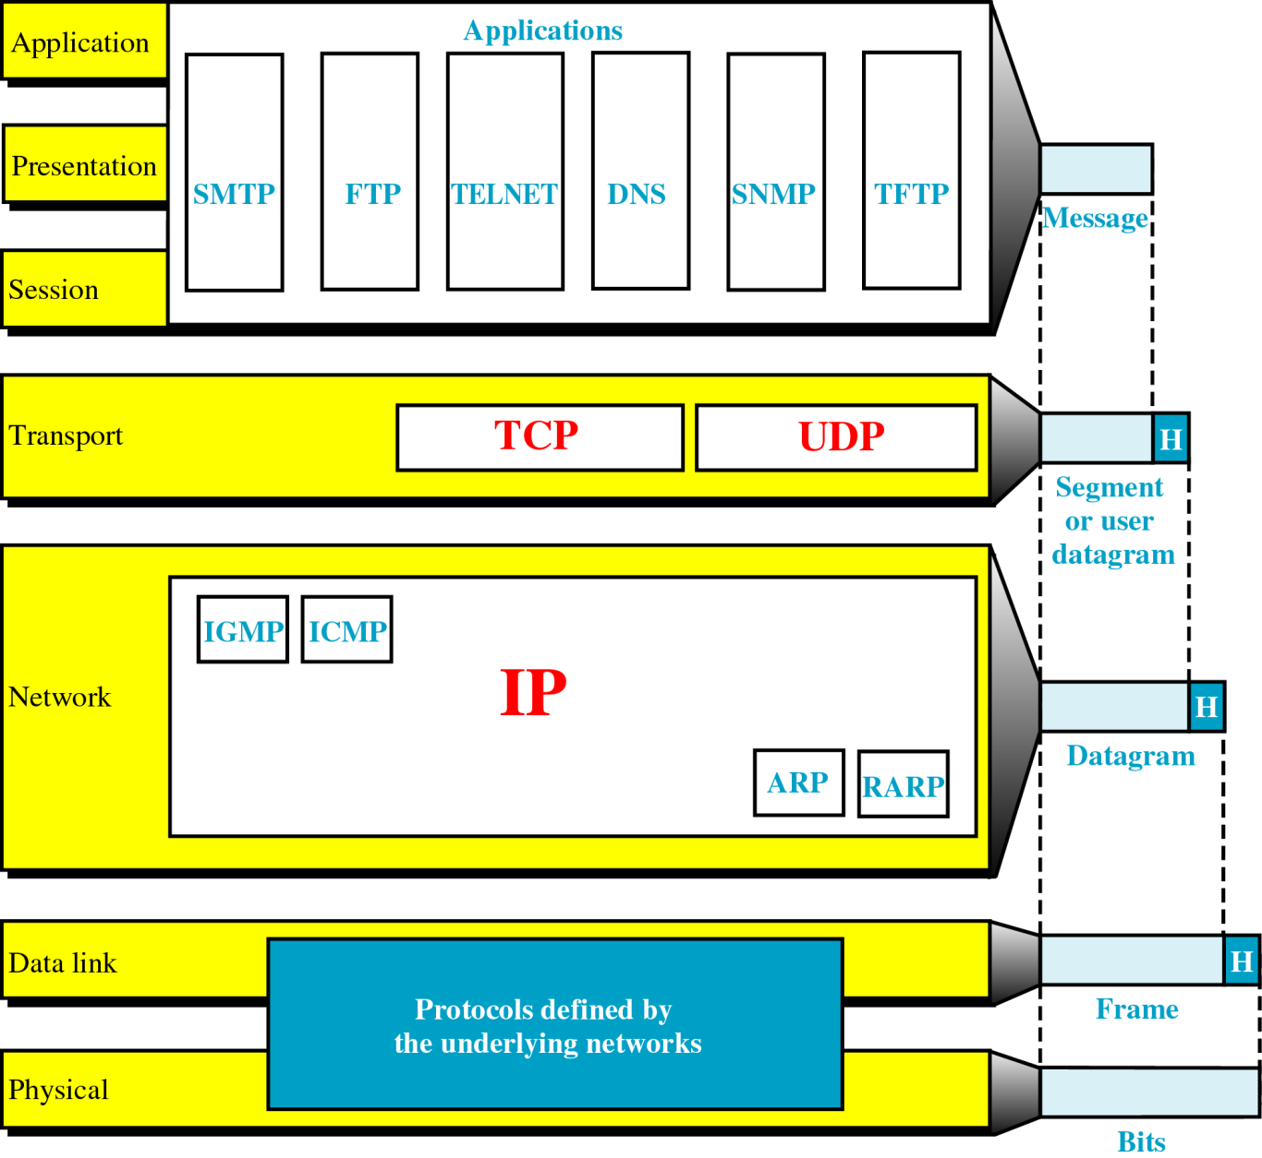
TCP/IP and the OSI Model

Slide 6
Construction of Datagrams….
Each #datagram has two components
  Header
  Payload
Header
+
Data (Payload)
Packet

Slide 7
IP Service
Delivery service of IP is minimal.
IP provides an unreliable connectionless best effort service
  Unreliable : IP doesn’t make an attempt to recover lost packets
  Connectionless : Each packet is handled independently
  Best Effort : IP doesn’t make guarantees on the service ( No through output , No delay guarantee…)

Slide 8
IP Service (Cont.…)
IP supports the following services
    One-to-one (unicast)
    One-to-all (broadcast)
    One-to-several (multicast)
unicast
broadcast
multicast

Slide 9
Orientation of Internet Protocol
IP is a Network Layer Protocol

Slide 10
Journey to IP Versions…
IPV(1-3) : were not formally assigned.
IPV4 : TCP/IP , 32bit IP address currently used.
IPV5 : Internet Stream Protocol (SP)
        Experimental Protocol
        Never Introduced for public use.
IPV6 : Designed to replace IPV4 , 128bit IP address

Slide 11
Features of IPV4…
Connectionless protocol and best effort based.
Simplicity
    It is simpler and easy to remember
    Require less memory
Familiarity
    Millions of devices are already knowing it
    Existing infrastructure already support it

Slide 12
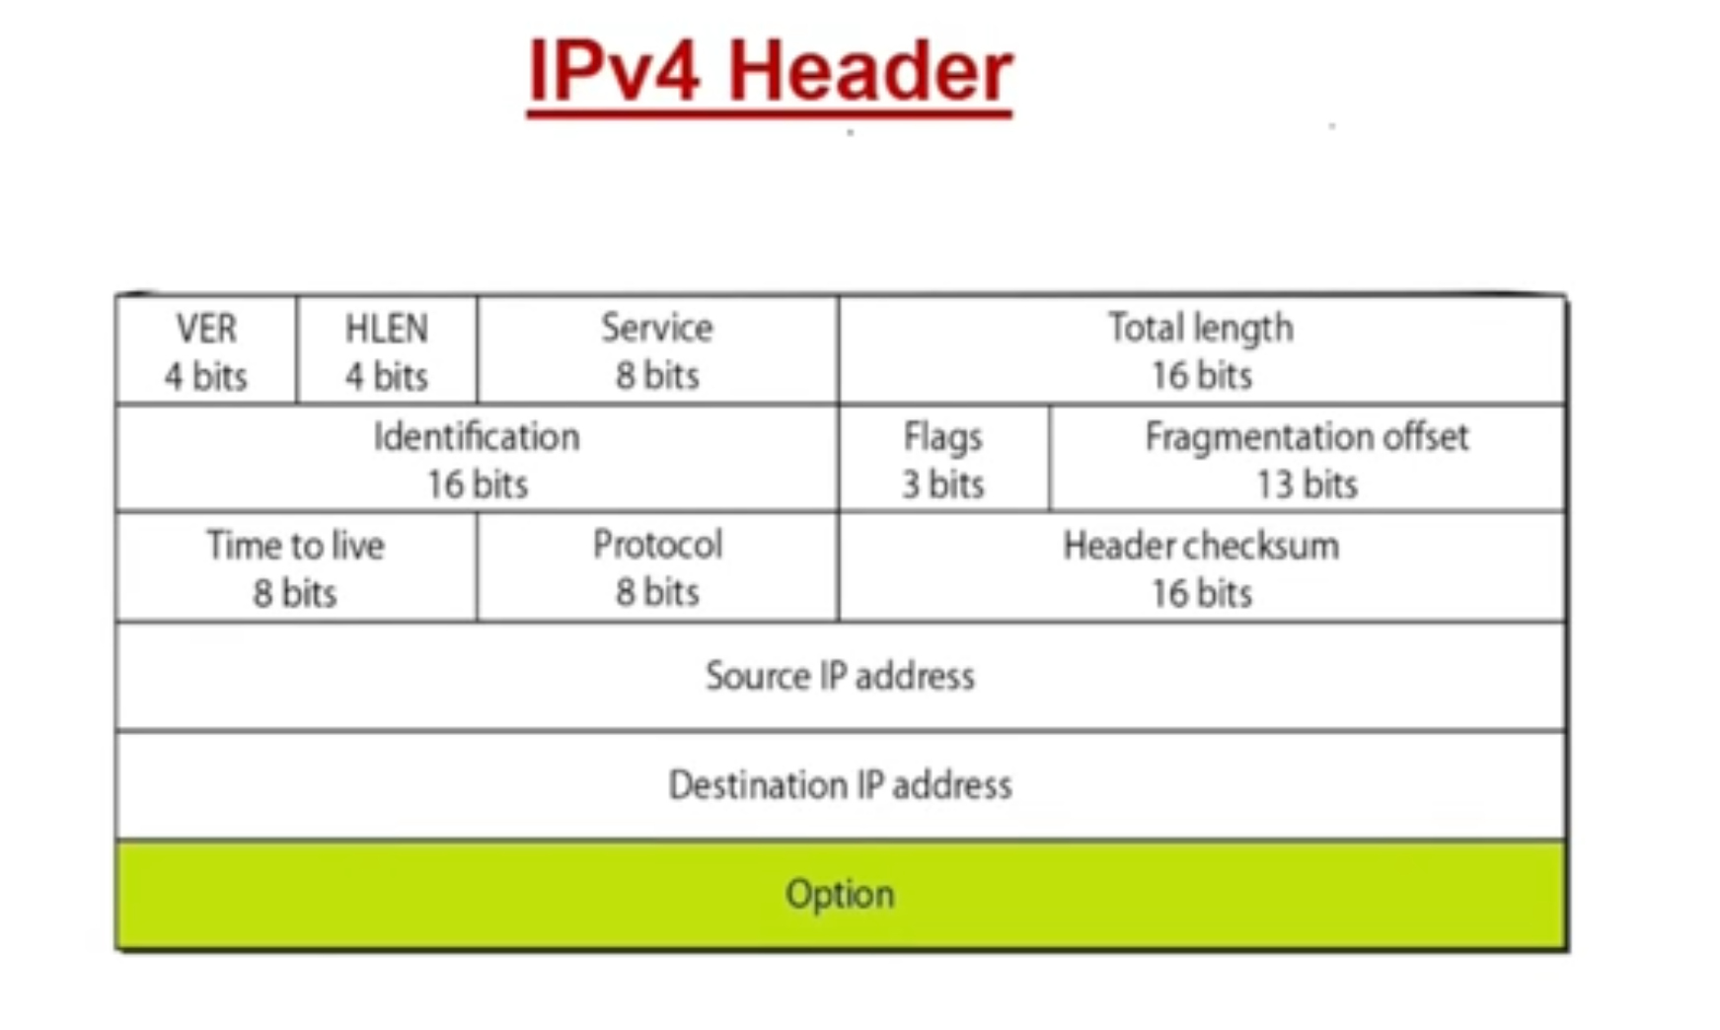

Slide 13
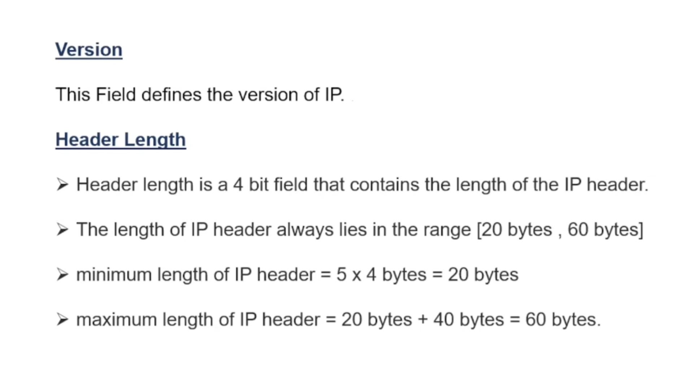

Slide 14
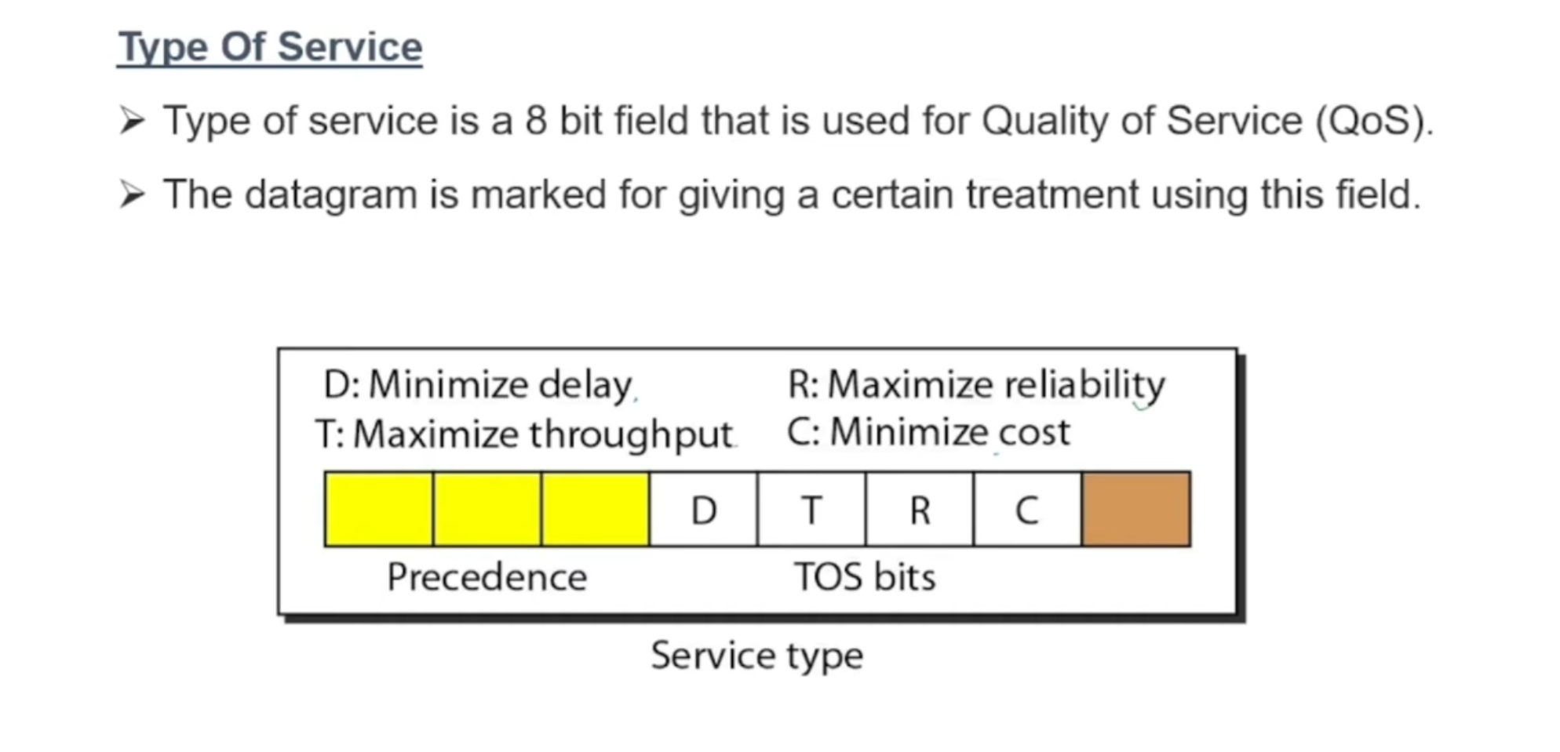

Slide 15
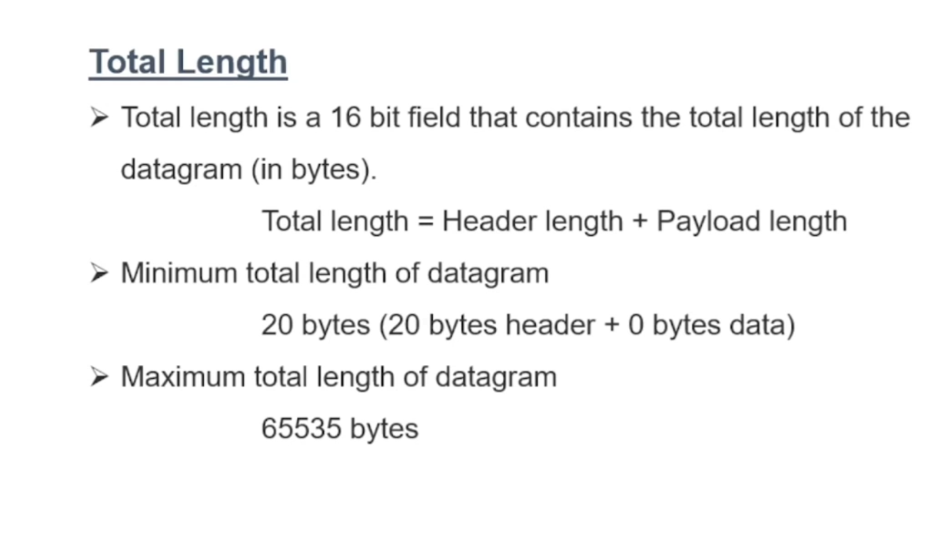

Slide 16
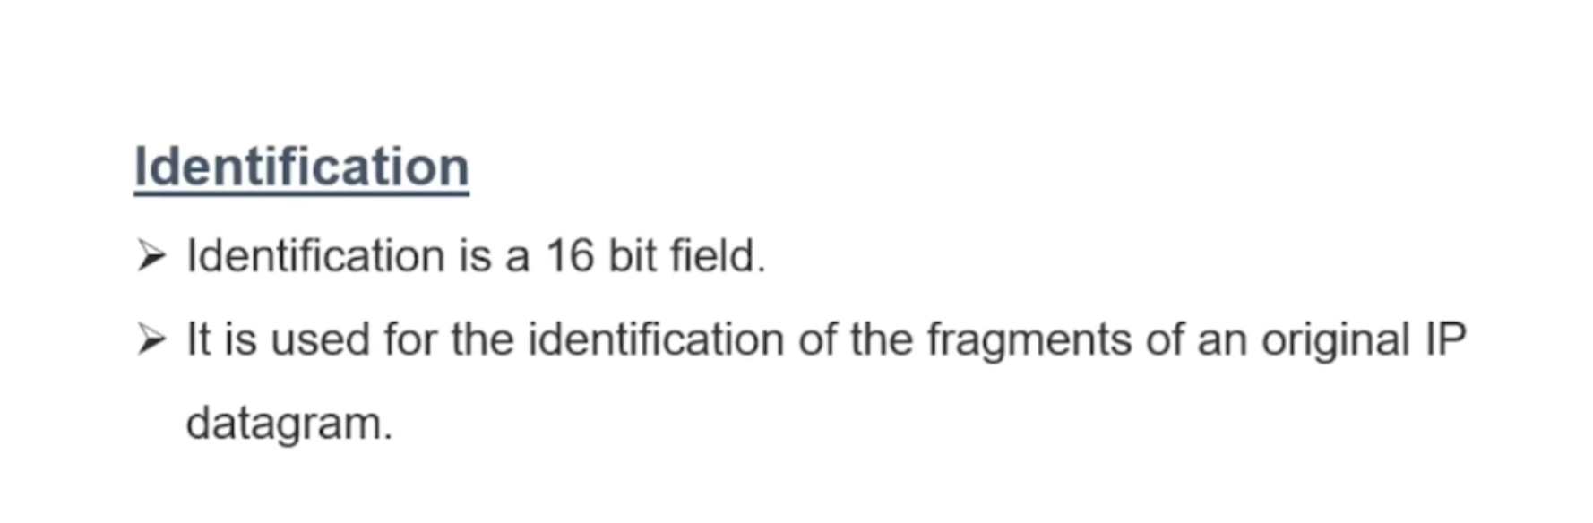

Slide 17
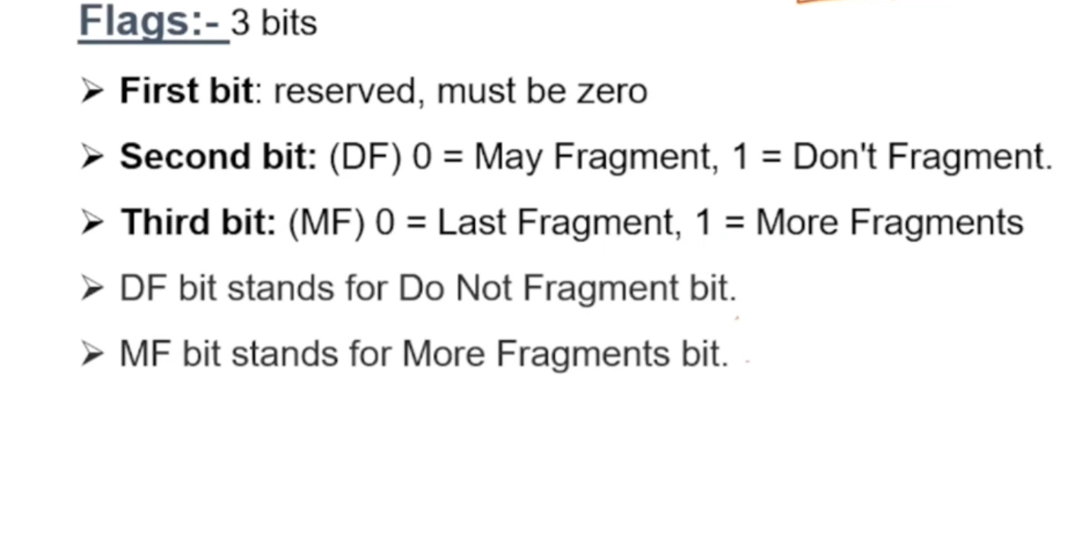

Slide 18
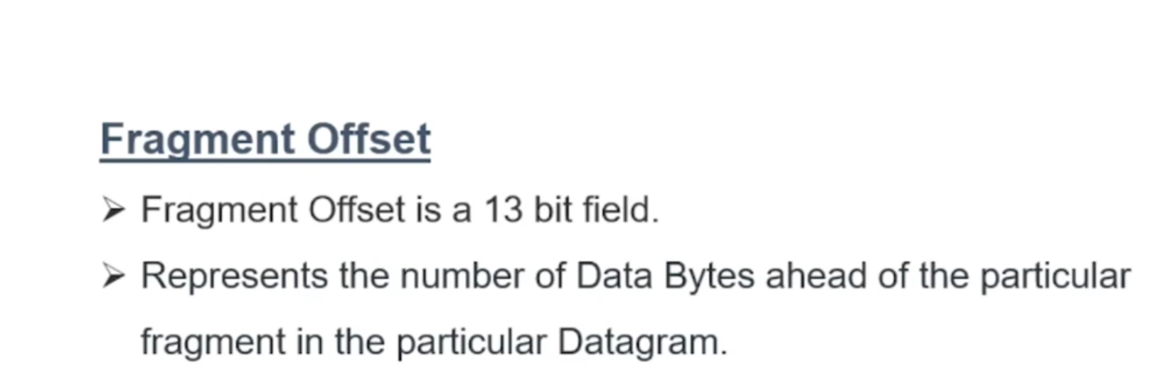

Slide 19
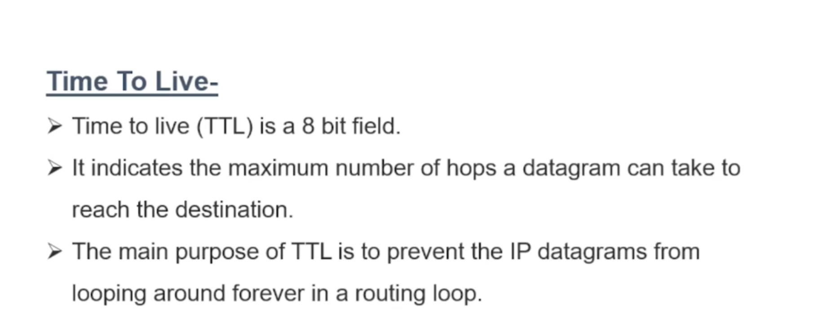

Slide 20
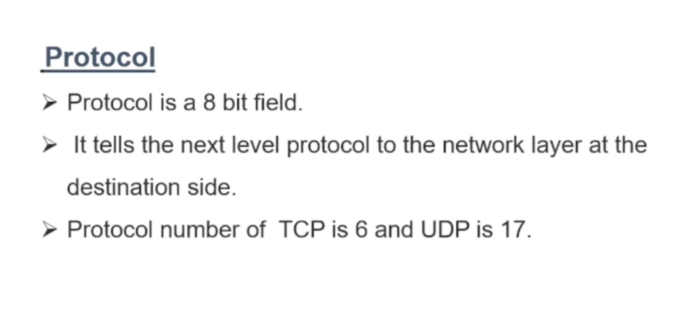

Slide 21
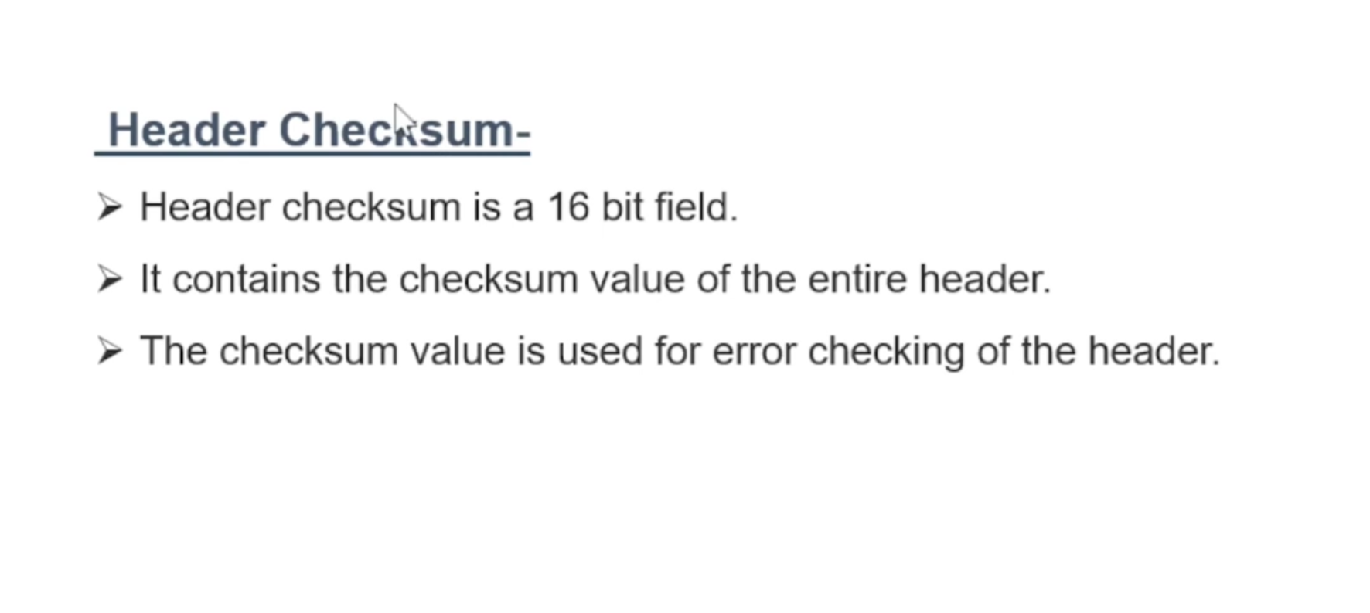

Slide 22
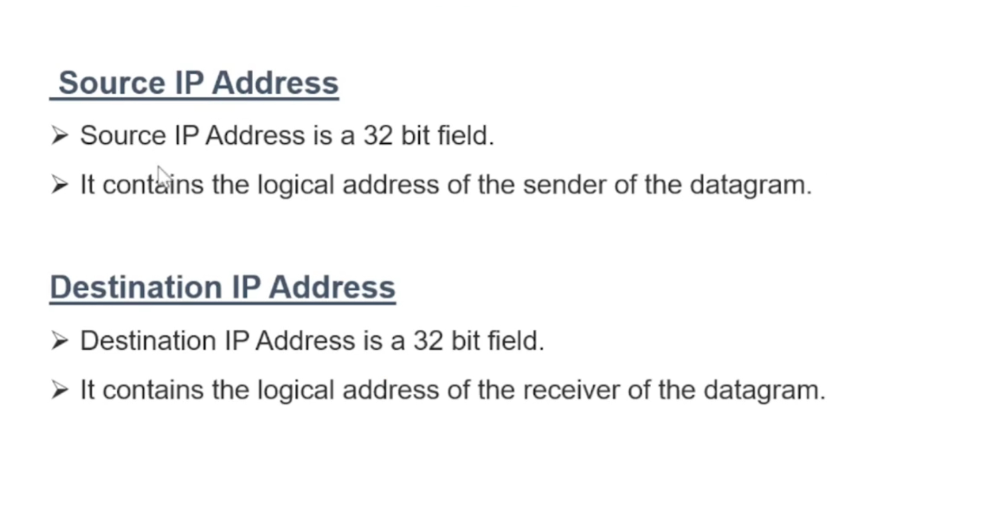

Slide 23
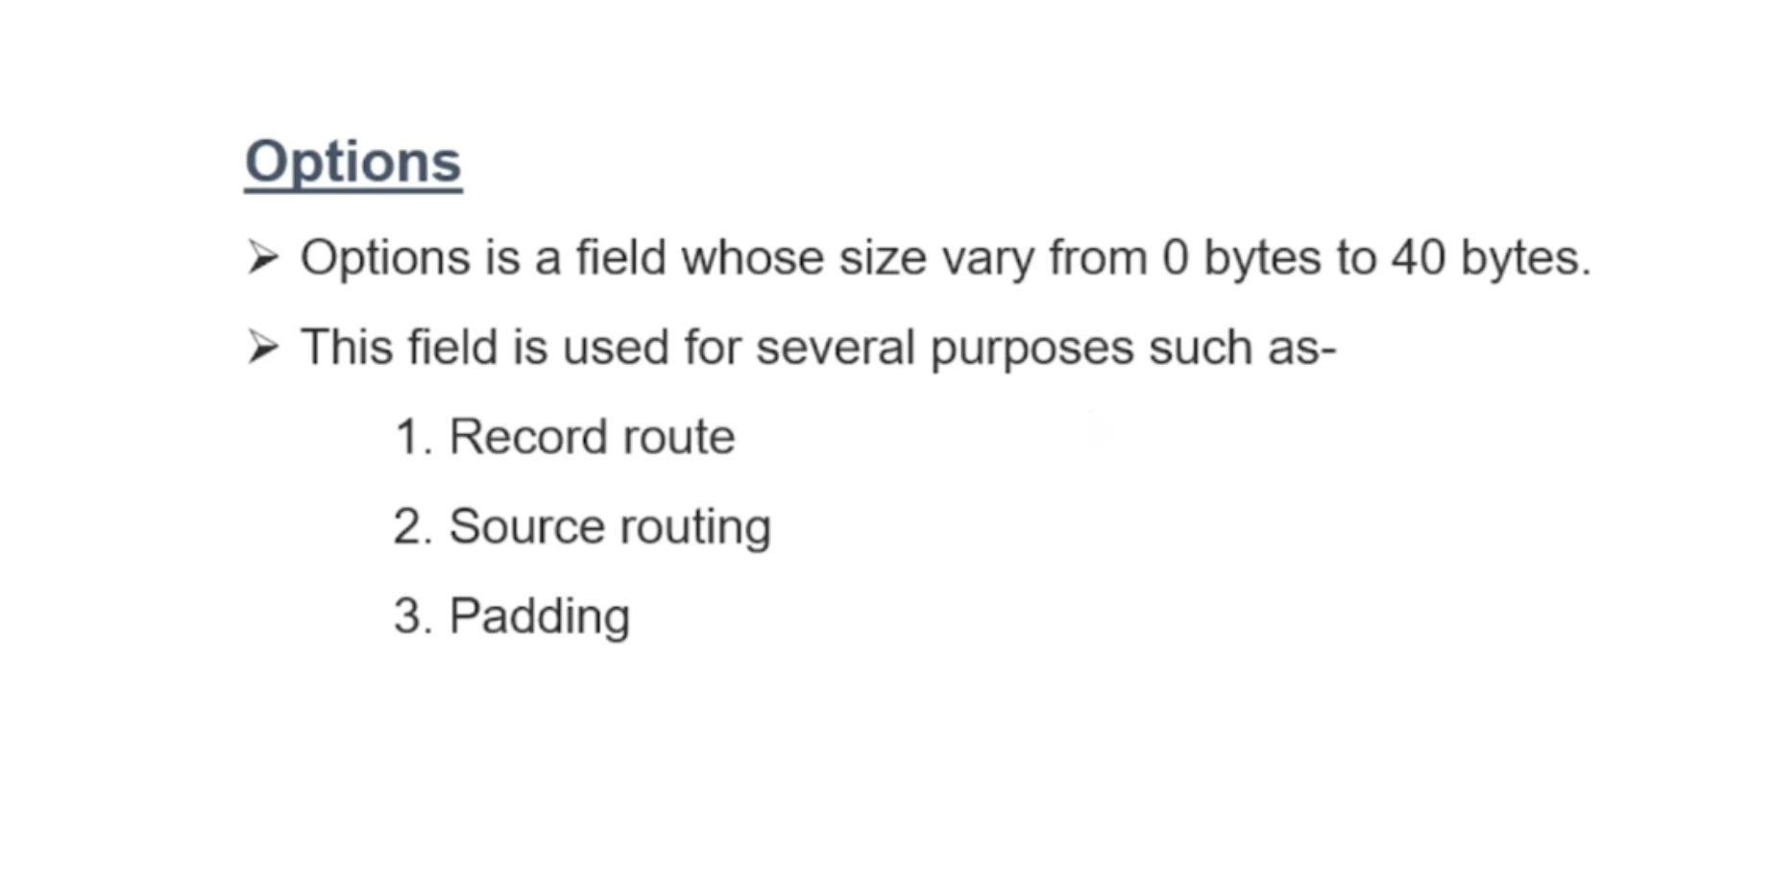

Slide 24
Benefits of IPV4….
Widely support
Support of all Operating Systems
All commonly used protocols are supported

Slide 25
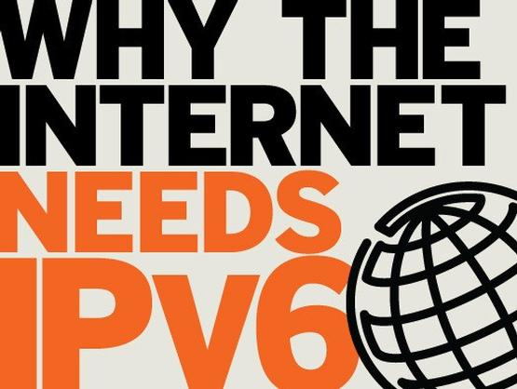
Why IPV6…..?
IPV6 provides a platform on new internet functionality that will be needed in the immediate future and provide
flexibility for future
growth and
expansion.

Slide 26
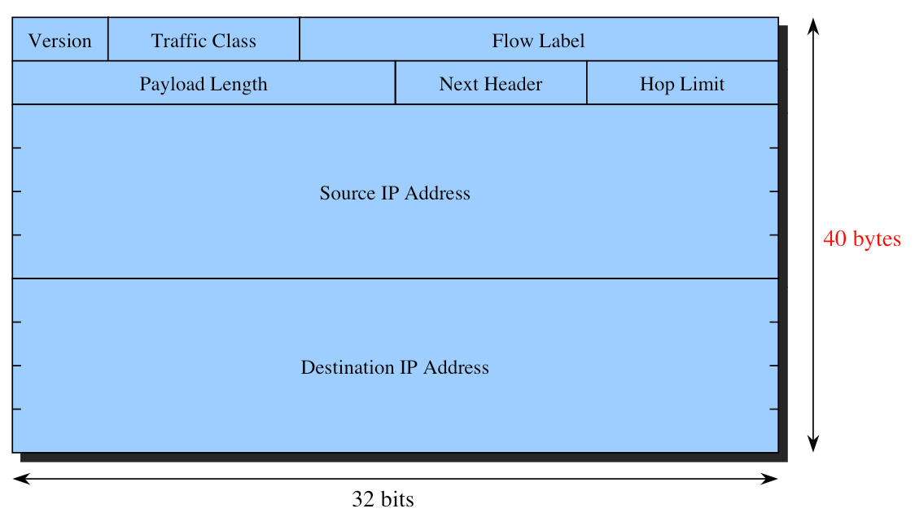
IPv6 Header

Slide 27
IPv6 Header Fields
• Version: IP version 6
• Traffic Class: used in congestion control similar to ToS field in IPv4.
• Flow Label: QoS management
• Payload length: payload length in bytes
• Next header: specifies the type of extension(if present)immediately following the IPv6 header
• Hop Limit: replaces the ttl field of IPv4
• Source and Destination addresses: 128
bits each

Slide 28
Benefits of IPV6…..
Large address space
New header format
Extensibility
IPV6
Built in Security
Better support for QoS
Efficient & hierarchical addressing and routing infrastructure

Slide 29
Difference between IPv4 & IPv6
S.N | IPv4 | IPv6
1. | Addresses are 32 bits (4 bytes) long. | Addresses are 128 bits (416 bytes) long.
2. | Both routers & sending host fragment the packets. | Routers don’t fragment the packets but sending host fragment the packets.
3. | Header includes a checksum. | Header doesn’t includes a checksum.

Slide 30
S.N | IPv4 | IPv6
4. | Classes of addressing are A, B, C, D, E. | Classes of addressing are unicast, anycast, multicast.
5. | Configure either manually or through DHCP. | Doesn’t require manual configuration.
6. | Must support a 576 byte packet size. | Must support 1208 byte packet size.

Slide 31
S.N | IPv4 | IPv6
7. | IPv4 address uses the dot-decimal notation. | IPv6 address are represented in a hexadecimal, colon-separated notation.
8. | Not suitable for mobile networks. | IPv6 is better suited to mobile networks.
9. | Address space is small (2³²). | Larger address space (2¹²⁸).

Slide 32
S.N | IPv4 | IPv6
10. | Internet protocol security(IPSec) is mandatory in this. | IPSec is optional.
11. | An IP address is made up of 4 bytes of information expressed as 4 number between 0 & 255 shown separated by periods. e.g.- 238.17.159.4 | An IPv6 address is represented by 8 group of 16 bit hexadecimal values separated by colons (:). e.g.- 2001:0db8:85a3:0000:0000:8a2e:0370:7334

Slide 33
IP Based Technologies..
Internet
VoIP
IP – TV
IP-VPN
Wireless Mobile Technology
Internet Broadcasting

